Slide 1
DEPI Project – Pet Clinic DevOps Track — GIZ1 SWD1 S3d Supervised by: Mohamed Shokry
Prepared by:
Mohamed Waleed Mohamed Abdelfattah — 21044904
Mahmoud Tarek Medany — 21026143
Esraa Shaaban — 21032361
Taqwa Elsayed Mohammed Fahmy — 21025433
Magdy Ayman Abu Bakr — 21003567
Omnia magdy abdelnaby — 21027962

Slide 2
Agenda
Dockerizing the Application
Testing
Webhooks to Trigger Jenkins
Jenkins Build and Test Stages
AWS & Ansible
Jenkins Refinement

Slide 3
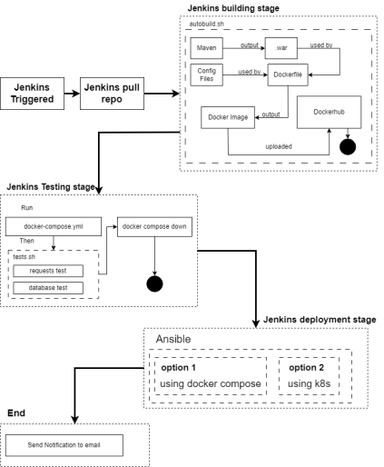
Pipeline Workflow
Step 1: Jenkins triggers on code commit.
Step 2: Jenkins pulls the latest code and
builds the Docker image.
Step 3: Automated unit tests are run.
Step 4: Docker image is pushed to Docker Hub
or a private registry.
Step 5: Ansible deploys the app to the cloud or a server.

Slide 4
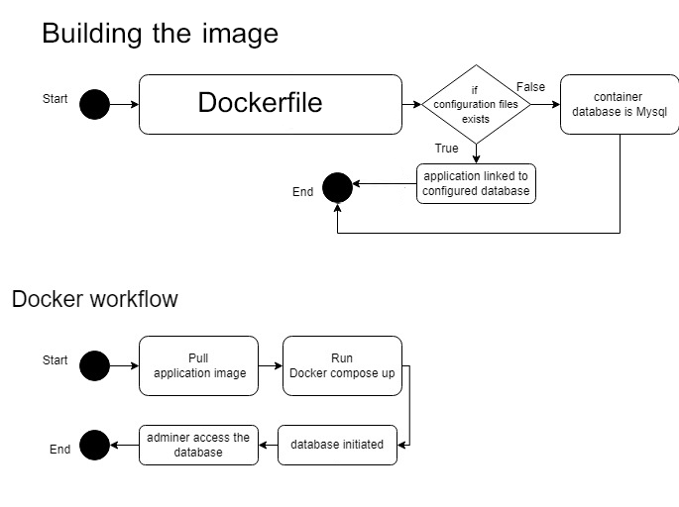
Dockerizing the Application

Slide 5
Files written
Dockerfile
docker-compose.yml
autobuild.sh
Next: Mahmoud Tarek Medany

Slide 6
Testing
To make it easier for Jenkins team to test the application behaviour the following scripts are written:
isOn.py: Testing if application is deployed
database.py: Testing database by adding record, checking if it exists, removing it.
tests.sh: install dependencies for previous python scripts
and run them.

Slide 7
Testing
isOn.py
The code checks if the web application at http://localhost:5050/petclinic is accessible and prints its HTTP status code to the console. If the web service is running and responds correctly, it will output something like "The website http://localhost:5050/petclinic is online with status code: 200". If the service is down returns traceback error to stop the pipeline.

Slide 8
Testing
database.py
This script performs the following sequence of actions:
Submits a form to a local web application.
Connects to a MySQL database and checks if an entry with the specified first and last name exists in the owners table.
If the entry exists, it deletes it from the database

Slide 9
Testing
tests.sh
This shell script automates the following processes:
Installs Python and the necessary Python packages.
Executes two Python scripts while checking for any errors in their execution.
Stops execution if any errors occur and prints appropriate messages.
it was made to ease the testing stage in the pipeline script in jenkins
Next: Taqwa Elsayed

Slide 10
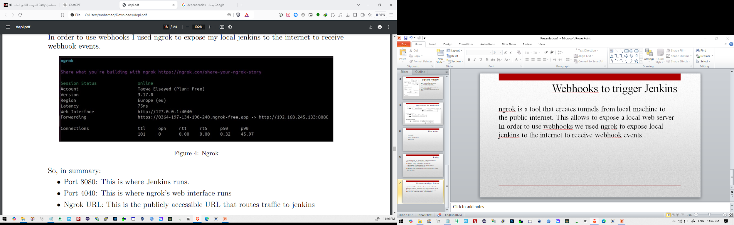
Webhooks to trigger Jenkins
Using ngrok to expose local jenkins

Slide 11
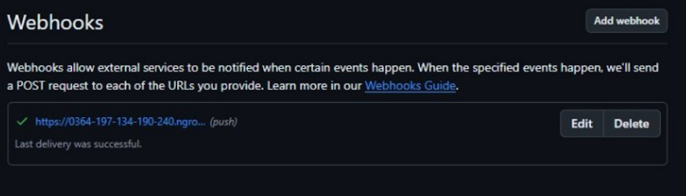
Webhooks to trigger Jenkins
Configuring Github Webhook

Slide 12
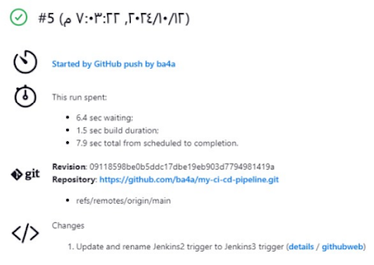
Webhooks to trigger Jenkins
Results
Next: Omnia magdy abdelnaby

Slide 13
Build and Test stages in Jenkins
Environment
IMG_NAME=’petclinic-tomcat:latest’ DOCKER_HUB_USR=’mohamedwaleed77’ DOCKER_REPO_NAME=’mohamedwaleed77/depi_petclinic:latest’ DOCKER_HUB_TOKEN=credentials(’dockerhub’)
added the variables to avoid repetitions and make the script more readable

Slide 14
Build and Test stages in Jenkins
Build Stage
stage(’Build’) {
steps {
sh ’./autobuild.sh’
sh "echo ${DOCKER_HUB_TOKEN} | docker login -u ${DOCKER_HUB_USR} --password-stdin"
sh "docker tag ${IMG_NAME} ${DOCKER_REPO_NAME}"
sh ’docker push ${DOCKER_REPO_NAME}’
}
}
used the pre-written shell script to build the image

Slide 15
Build and Test stages in Jenkins
Testing Stage
stage(’Testing’) {
steps {
sh ’docker compose up -d && sleep 60’
dir("test_scripts") {
sh ’./tests.sh’
}
}
running the image and adding 60 seconds for manual testing if wanted
used pre-written shell script to test the image

Slide 16
Build and Test stages in Jenkins
At the end
post {
success { . . . }
failure { . . . }
always{
script{
sh ’docker compose down’
sh ’rm -rf target && sudo rm –rf savedata_mw’
}
}
}
removing savedata_mw required sudo permissions to remove it as to the system, the directory owner is systemd-coredump. not Jenkins user.
always means to run this script regarding if the pipeline failed or succeeded
Next: Esraa Shaaban

Slide 17
AWS & Ansible
Overview
The playbook is designed to automate the deployment of a Docker container for the DEPI Pet Clinic application.

Slide 18
AWS & Ansible
Infrastructure Setup
EC2 Instance Configuration
Security Group Configuration
Inventory Configuration
Ansible Playbook

Slide 19
AWS & Ansible
Playbook Breakdown
• Update apt cache
• Install Docker dependencies
• Install Python3 and venv
• Create a Python virtual environment
• Install Docker SDK for Python
• Download Docker installation script
• Run Docker installation script
• Ensure Docker is running
• Pull the Docker image
• Stop and remove existing container
• Run the new Docker container

Slide 20
AWS & Ansible
Deployment Steps
• Prepare the Environment
• Run the Playbook
• Accessing the Application
Next: Mohamed Waleed

Slide 21
Jenkins Refinement
This part completed by Magdy Ayman Abu Bakr
Key changes:
Instead of using Webhooks we used poll SCM which is less efficient but more simple
Set Up Notifications
Integrated all pipeline scripts to make one final script.

